Slide 1
Impact of Air Pollution on Public Health
A Multi-City Analysis Using Air Quality and Meteorological Data

Slide 2
Question for Research
How have levels of key air pollutants (PM2.5, PM10, NO₂, SO₂, CO, O₃) changed in major global cities in 2024?
Which cities consistently exhibit the highest or lowest levels of air pollution?
Which pollutants are most dominant in high-risk cities, and how do they compare across locations?
Are there noticeable improvements or deteriorations in air quality trends for specific cities in one year?
How can these pollution trends be interpreted in the context of known public health risks, such as respiratory or cardiovascular diseases?

Slide 3
Dataset Overview
Primary Dataset: Global Air Quality (2024 Snapshot)
Source: Kaggle – Global Urban Air Quality Index Dataset
Scope: 50+ major global cities across multiple continents
Time Frame: Focused exclusively on the year 2024
Pollutants Tracked:
PM2.5, PM10, NO₂, SO₂, CO, O₃
Meteorological Data Included:
Temperature, Humidity, Wind Speed
Secondary Dataset: Health Impact (Used for Model Training)
Source: Kaggle – Air Quality and Health Impact Dataset
Used to train machine learning models for:
Predicted Respiratory, Cardiovascular and Hospital Admissions Cases
Also used to establish pollution–health relationships (e.g., PM2.5 → respiratory illness)

Slide 4
Methodology
1. Data Cleaning
Removed missing rows and standardized pollutant columns
2. Aggregation
Grouped data by city
Calculated average pollutant levels for each city in 2024
3. Descriptive Analysis
Analyzed distributions and identified cities with extreme pollution levels
4. Visualization
Used bar charts, heatmaps, and scatter plots
Highlighted top polluted cities and visualized predicted health risks
Created stacked bar and lollipop charts to compare total health burden across cities
Developed a Health Burden Index and risk classification to support policy interpretation

Slide 5
Methodology
5. Machine Learning Models
Trained Random Forest models to predict:
1) Respiratory Cases
2) Cardiovascular Cases
3) Hospital Admissions
Evaluated using RMSE
Applied models to city data for 2024 predictions
6. Interpretation of Results
Ranked cities by predicted health burden
Identified dominant pollutants (e.g., O₃) using feature importance
Connected findings to health risks reported in prior research

Slide 6
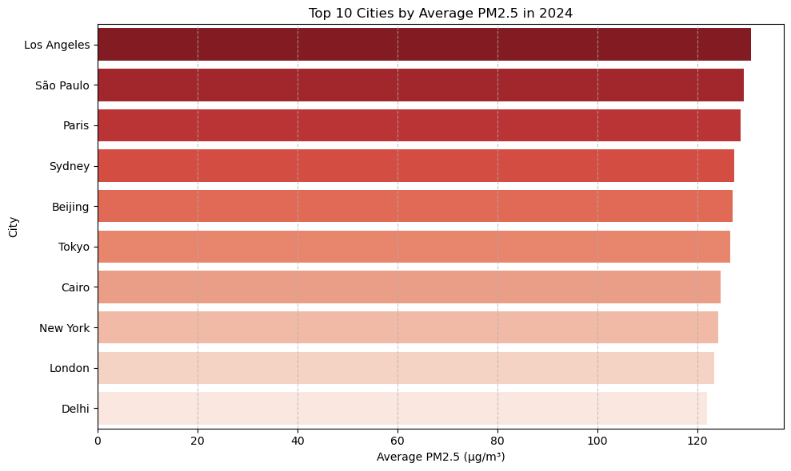
Key Results
Air quality analysis for the year 2024 revealed noticeable variation in pollution levels across major global cities.
Based on average PM2.5 values, the most polluted cities included Los Angeles, São Paulo, Paris, Sydney, and Beijing,
indicating a higher potential exposure to fine particulate matter in these locations.
In contrast, cities such as Delhi, London, New York, Cairo, and Tokyo recorded comparatively lower average pollutant levels.

Slide 7
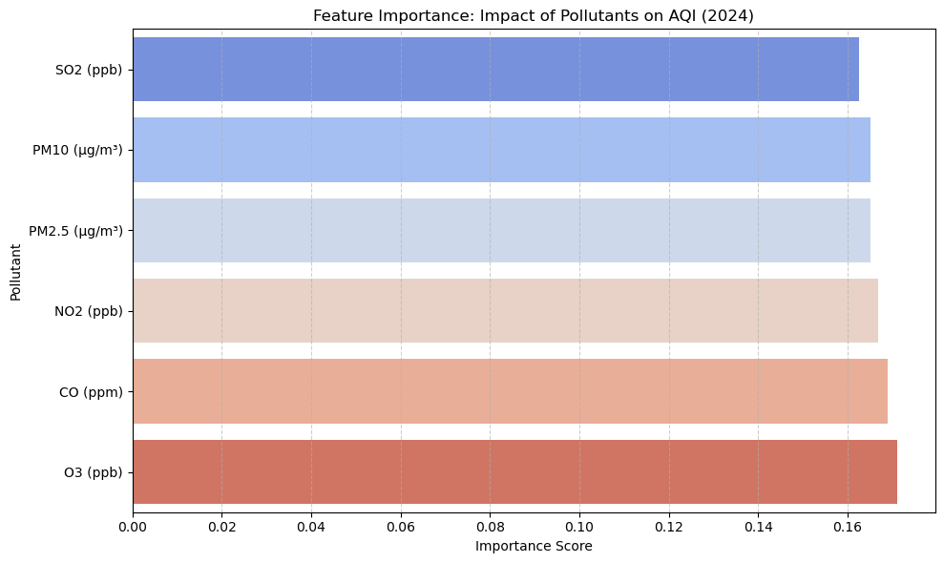
Key Results
Pollution variables were ranked using feature importance from the trained machine learning models.
Ozone (O₃) was identified as the most influential pollutant in predicting health outcomes, followed by PM2.5 and NO₂.
These results highlight O₃ as a key contributor to pollution-related health risks,
reinforcing its role in conditions such as respiratory and cardiovascular illness.

Slide 8
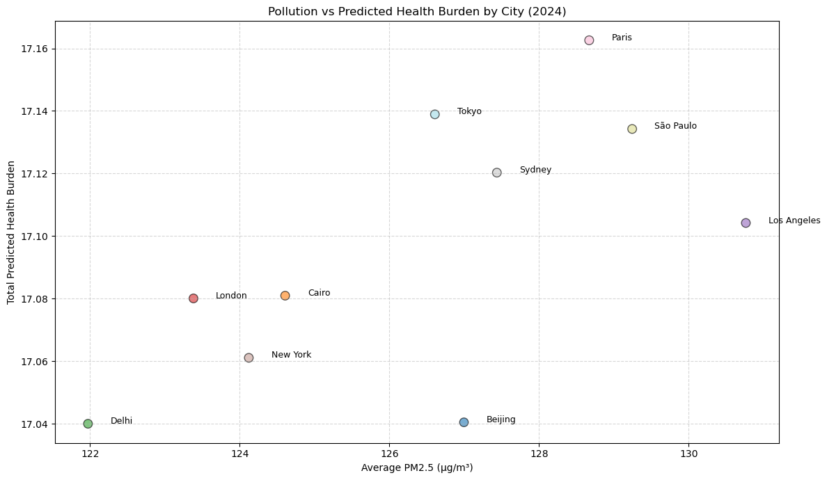
Key Results
Machine learning models were used to estimate health impacts for each city based on pollution exposure in 2024.
Predictions included average cases of respiratory illness, cardiovascular conditions, and hospital admissions.
Cities such as Paris, Tokyo, and São Paulo consistently showed higher predicted health burdens across all categories.
These results provide a clearer understanding of how pollution levels may translate into real-world health outcomes.

Slide 9
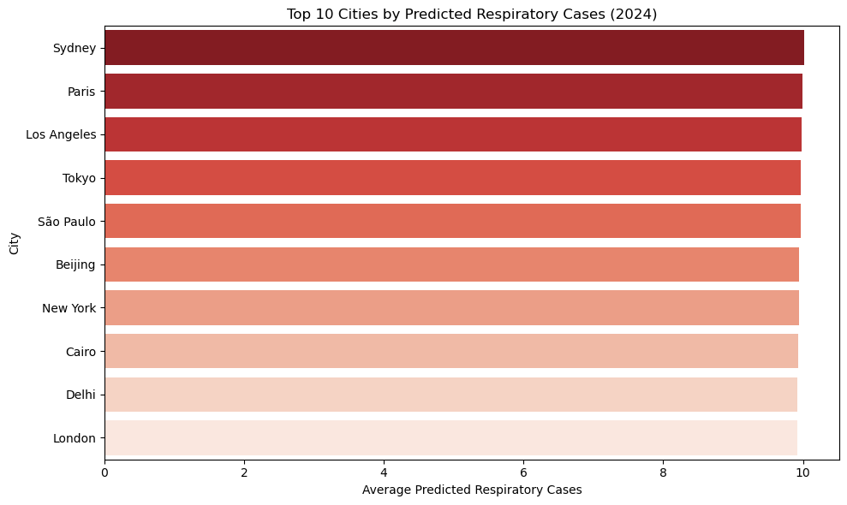
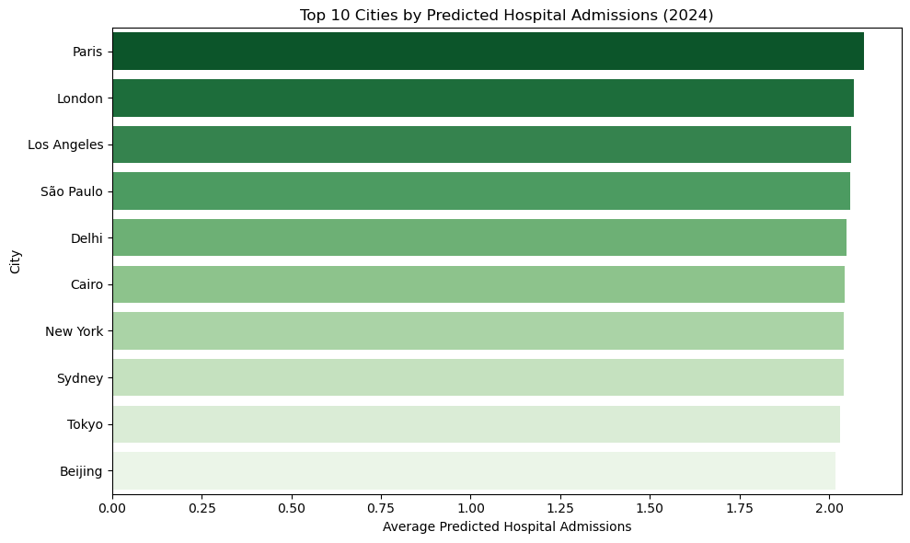
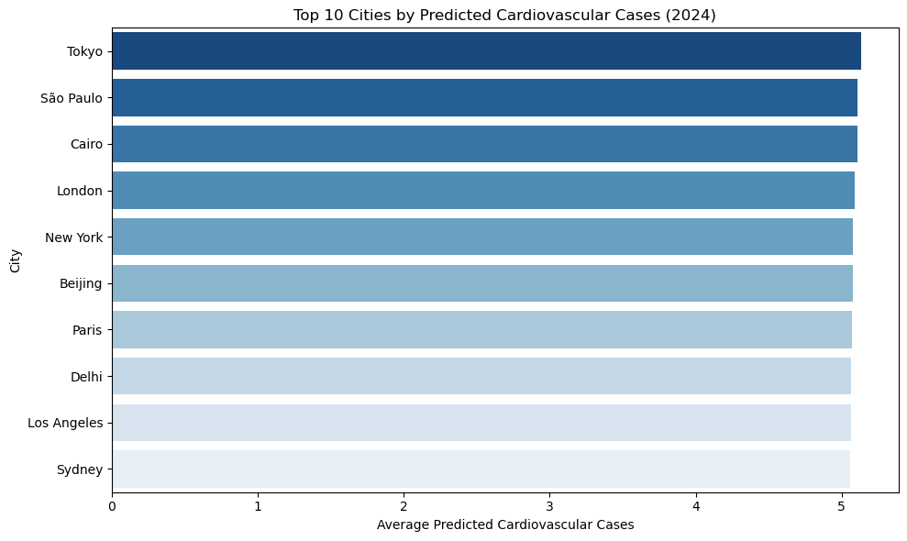
Key Results
Machine learning models were built to predict three major health outcomes:
respiratory cases, cardiovascular cases, and hospital admissions.
Cities were ranked by their average predicted cases in 2024, using pollution data as input.
Paris, São Paulo, and Tokyo appeared consistently in the top 10 across all three health categories.
PM2.5 and O₃ emerged as dominant pollutants driving predicted health risks.
These findings highlight cities that may face greater pressure on healthcare systems due to pollution-linked illnesses.
The combined chart view provides a comparative snapshot of where predicted health burdens are likely to be most severe.

Slide 10
Discussion on Health Impact
How Air Pollutants Affect Public Health
1. PM2.5 (Fine Particulate Matter)
Tiny particles that reach deep into the lungs and bloodstream
Associated with asthma, bronchitis, heart disease, and premature death
WHO annual limit: 5 µg/m³
Several cities in our analysis exceeded this limit
2. NO₂ (Nitrogen Dioxide)
Emitted from vehicles and industrial activity
Linked to lung inflammation, childhood asthma, and reduced lung function
WHO annual limit: 10 µg/m³
Levels were notably high in multiple urban areas
3. SO₂ (Sulfur Dioxide)
Produced by burning fossil fuels
Triggers airway irritation and can worsen asthma
Detected at moderate levels across some cities
4. O₃ (Ozone)
Formed through chemical reactions in the atmosphere
Can cause chest tightness and shortness of breath
Risk increases during hot, sunny conditions
5. CO (Carbon Monoxide)
A byproduct of combustion from vehicles and industry. Reduces oxygen delivery to the body, stressing the heart

Slide 11
Discussion and Future Scope
This study demonstrates how machine learning can be used to link air pollution with public health risks. By training predictive models on health outcome data and applying them to city-level pollution exposure, the project offers a scalable approach to estimate future health impacts and guide policy decisions.
Limitations:
The analysis was based on 2024 data only, which limits the ability to observe trends or changes over time.
Population and socioeconomic variables were not included, which could provide context for vulnerability or risk adjustment.
The health data used for model training was synthetic and may differ from real-world public health datasets in complexity or variability.
Regional comparisons were not included due to lack of continent or economic classification in the dataset.
Proposed Next Steps:
Extend the analysis over multiple years and across regions to capture trends, improvements, and disparities in pollution and health outcomes.
Integrate additional datasets (e.g., population, GDP, hospital capacity) and develop an interactive tool to support targeted policy interventions.

Slide 12
References
[1] Global Urban Air Quality Index Dataset – Kaggle https://www.kaggle.com/datasets/swapnilmishra/global-urban-air-quality-index-dataset
[2] Air Quality and Health Impact Dataset – Kaggle https://www.kaggle.com/datasets/rabieelkharoua/air-quality-and-health-impact-dataset
[3] B. R. Gurjar, K. Ravindra, and A. S. Nagpure, “Air pollution trends over Indian megacities and their local-to-global implications,” Atmospheric environment (1994), vol. 142, pp. 475–495, 2016, doi: 10.1016/j.atmosenv.2016.06.030.
[4] M. Fahim, Md. E. Uddin, R. Ahmed, Md. R. Islam, and N. Ahmed, “A Machine Learning Based Analysis Between Climate Change and Human Health: A Correlational Study,” in 2022 International Conference on Computer and Applications (ICCA), IEEE, 2022, pp. 1–6. doi: 10.1109/ICCA56443.2022.10039484.
[5] WHO Air Quality Guidelines (2021 Update) https://www.who.int/news-room/fact-sheets/detail/ambient-(outdoor)-air-quality-and-health
[6] scikit-learn: Machine Learning in Python https://scikit-learn.org

Slide 13
Thank you for your attention! Questions and discussion are welcome.

